Slide 1
LOWER ADIRONDACK SEARCH and RESCUE
……that others may live

Slide 3
What is Lower Adirondack Search and Rescue?
Lower Adirondack Search and Rescue (LASAR) is a wilderness search and rescue team based out of Warrensburg, N.Y.
The team has more than 60 volunteers who are dedicated to searching for lost people. We do this by extensive training including classroom and field exercises.
LASAR is a member of the New York Federation of Search and Rescue.

Slide 4
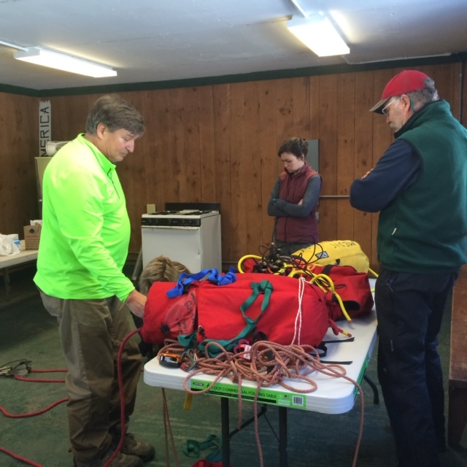
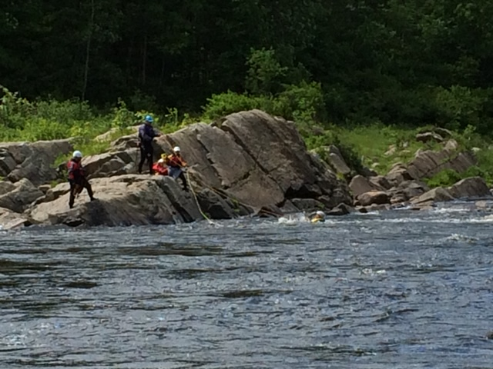
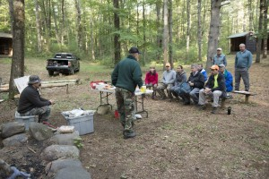
Training

Slide 5
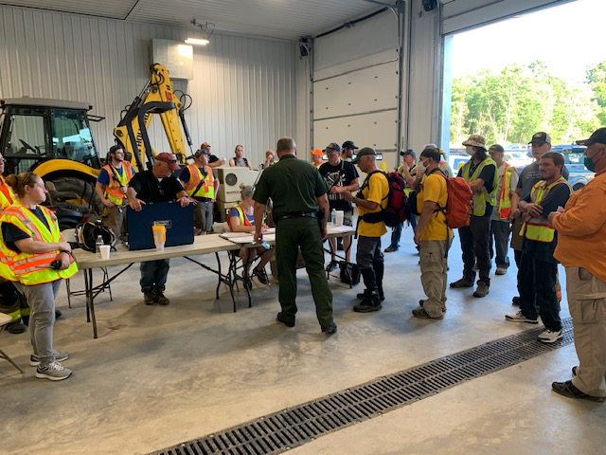
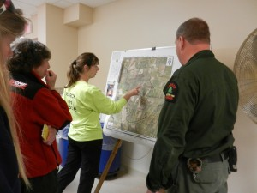
Responding to a Search
The New York State Department of Environmental Conservation is the responsible government agency for search and rescue. Requests for searchers are made by the DEC Forest Rangers. A search call-out to the team is then activated by a LASAR officer.

Slide 6
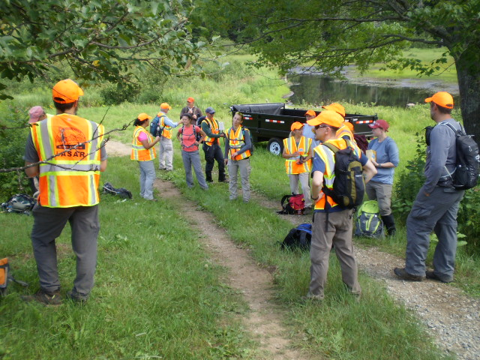
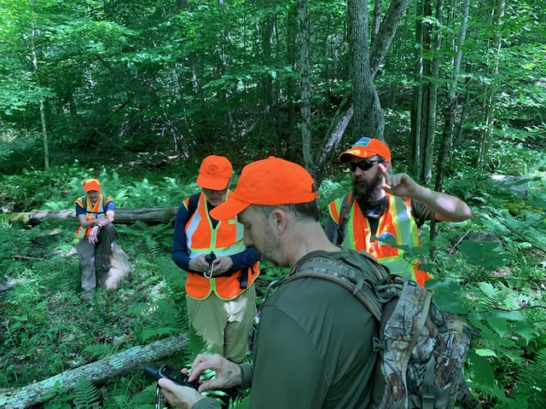
Getting organized
at the start

Slide 7
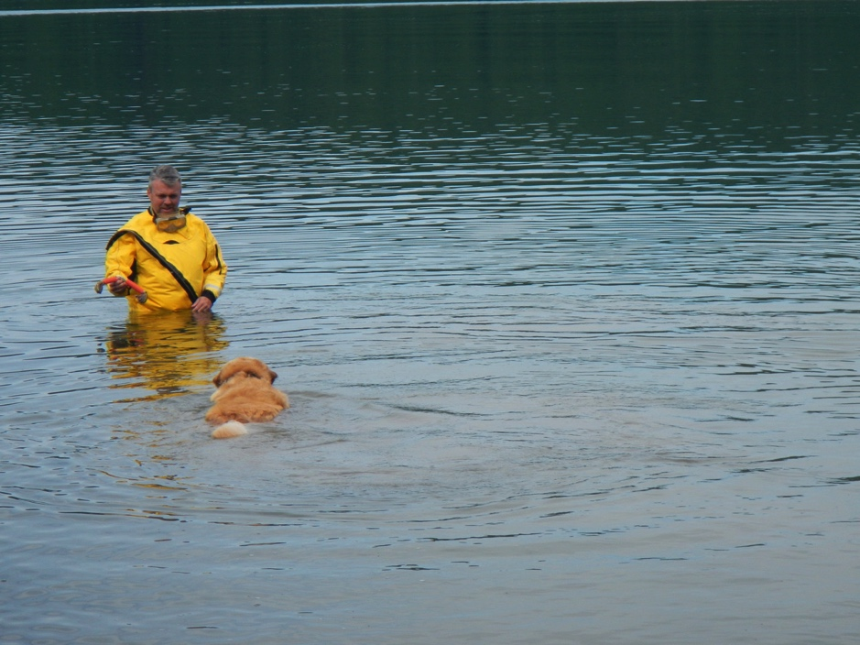
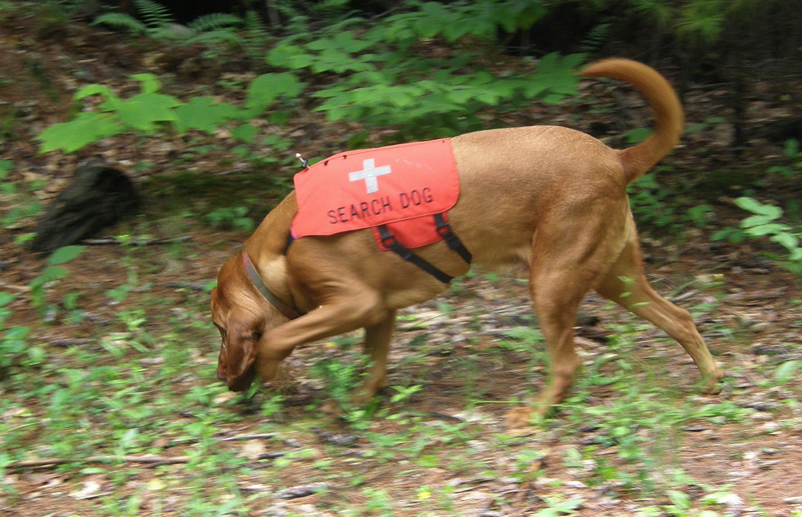
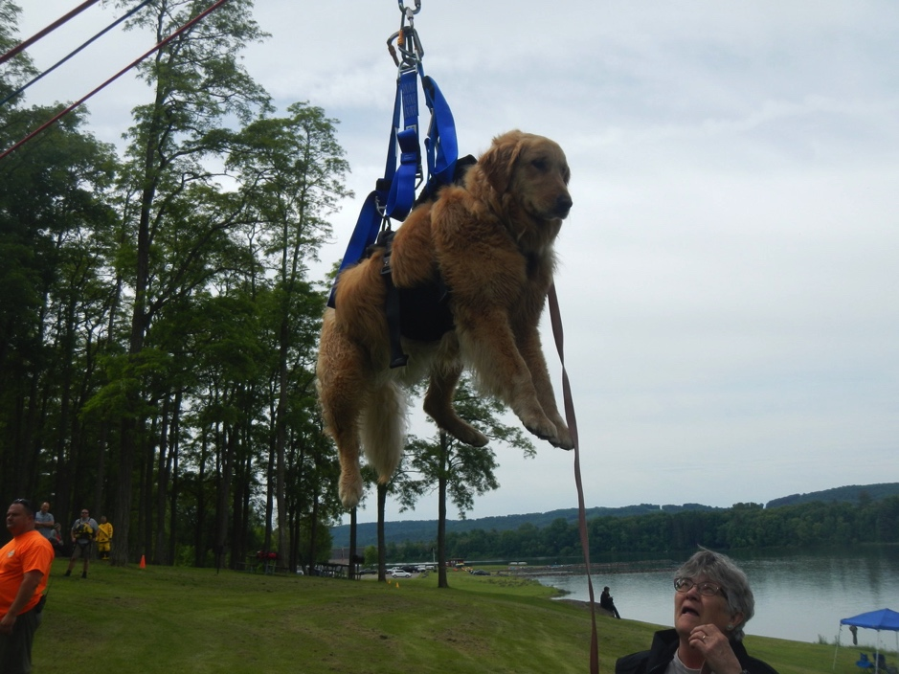
LASAR K-9 Team
Dogs are often a valuable resource at a search. LASAR has ongoing training for search dogs and their handlers.

Slide 8
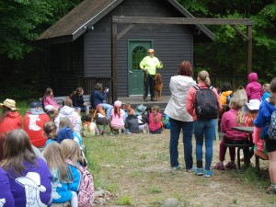
That Others May Live…….
Part of the mission of the Lower Adirondack Search and Rescue team is to provide public education. Along with outdoor safety information LASAR teaches a program called Hug-A-Tree to children ages 6-13 to help them keep safe and to survive if they become lost.

Slide 9
LOWER ADIRONDACK SEARCH and RESCUE
If you would like more information
Please visit our website:
lasarny.org

