Slide 1
Friends of Moreau Lake State Park JEOPARDY
Friends of Moreau Lake State Park
Support for Park Activities and Events
Activities and Events Sponsored by FOMLSP
Environmental Education
Stewardship
20
20
20
20
20
40
40
40
40
40
60
60
60
60
60
80
80
80
80
80
100
100
100
100
100

Slide 2
Friends of Moreau Lake State Park
20
It is a 100 % volunteer 501(c)3 non-profit corporation that
• Facilitates and organizes events and projects at the Park
• Purchases supplies, equipment, and food for folks and critters

Slide 3
Friends of Moreau Lake State Park
20
It is a 100 % volunteer 501(c)3 non-profit corporation that
• Facilitates and organizes events and projects at the Park
• Purchases supplies, equipment, and food for folks and critters
What is FOMLSP ?

Slide 4
Friends of Moreau Lake State Park
40
This states: To partner with MLSP to enrich the experience of every park visitor through environmental education, events, and stewardship.

Slide 5
Friends of Moreau Lake State Park
40
This states: To partner with MLSP to enrich the experience of every park visitor through environmental education, events, and stewardship.
What is the mission of FOMLSP ?

Slide 6
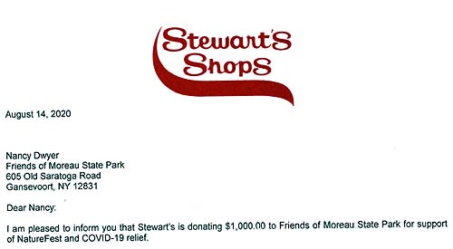
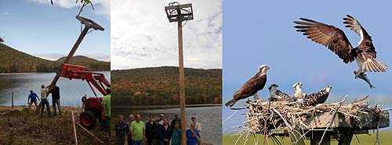
Friends of Moreau Lake State Park
60
These are groups of Friends who
• work to raise funds for events and improvements
• plan and help implement improvements for MLSP
• plan and help carry out events at MLSP
• work to recruit and sustain members

Slide 7
Friends of Moreau Lake State Park
60
These are groups of Friends who
• work to raise funds for events and improvements
• plan and help implement improvements for MLSP
• plan and help carry out events at MLSP
• work to recruit and sustain members
What are FOMLSP grants, projects, events, and membership committees ?

Slide 8
Friends of Moreau Lake State Park
80
This is a group of Friends and Gardeners who help beautify MLSP

Slide 9
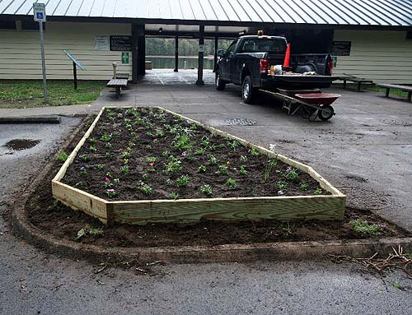
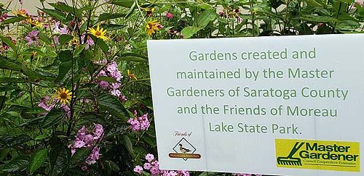
Friends of Moreau Lake State Park
80
This is a group of Friends and Gardeners who help beautify MLSP
Who are the garden committee and the Master Gardeners of Saratoga County ?

Slide 10
Friends of Moreau Lake State Park
100
These are social Media that FOMLSP uses to tell the world about fabulous Moreau Lake State Park

Slide 11
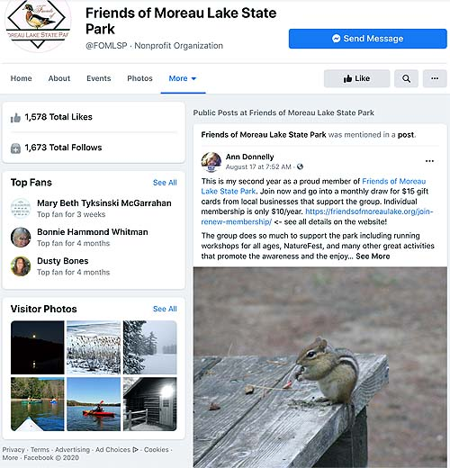
Friends of Moreau Lake State Park
100
These are social Media that FOMLSP uses to tell the world about fabulous Moreau Lake State Park
What are our web site (www.FriendsofMoreauLake.org)
and our FaceBook page ? (@FriendsOfMoreauLake)

Slide 12
Environmental Education
20
This is the place where Friends help the Park Environmental Educator(s)

Slide 13
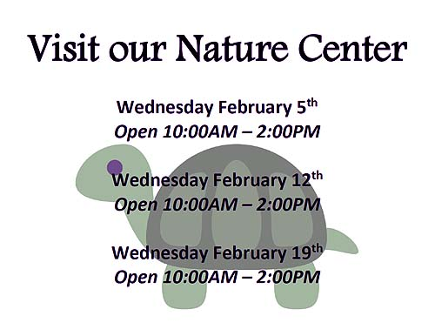
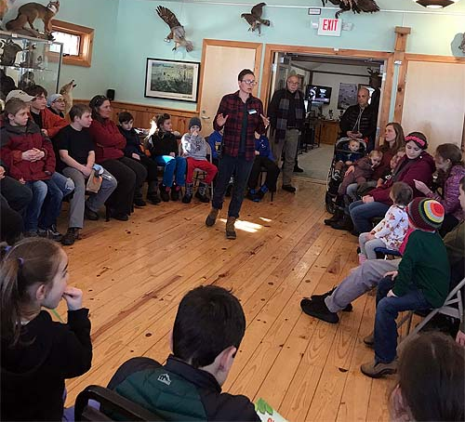
Environmental Education
20
This is the place where Friends help the Park Environmental Educator(s)
What is the Nature Center ?

Slide 14
Environmental Education
40
This is a fine way to learn about MLSP after dusk

Slide 15
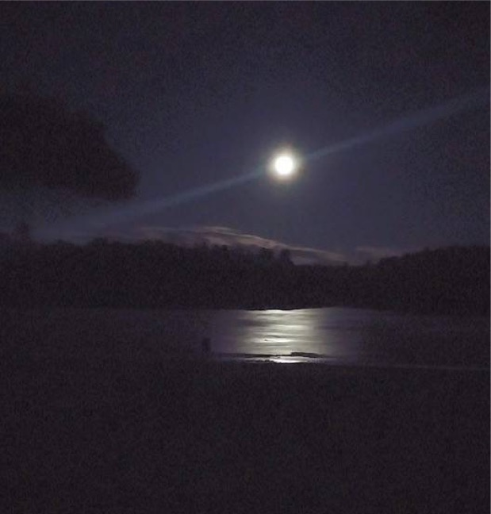
Environmental Education
40
This is a fine way to learn about MLSP after dusk
What is joining a full moon hike ?

Slide 16
Environmental Education
60
This is a FOMLSP event that includes environmental education

Slide 17
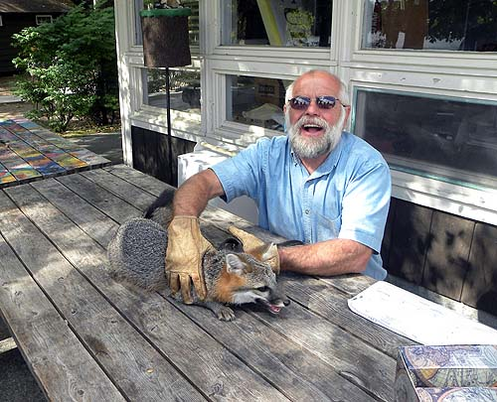
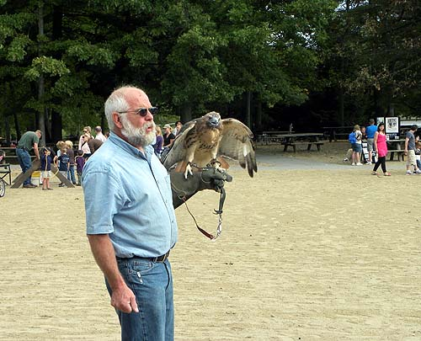
Environmental Education
60
This is a FOMLSP event that includes environmental education
What is Nature Fest ?

Slide 18
Environmental Education
80
This is a chance to get up close and personal with a snake

Slide 19
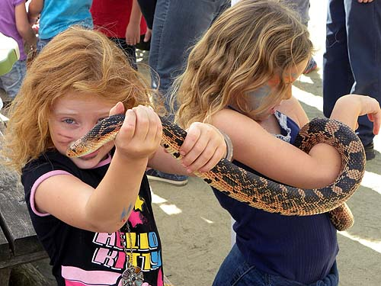
Environmental Education
80
This is a chance to get up close and personal with a snake
What is part of environmental education at Nature Fest ?

Slide 20
Environmental Education
100
This is a chance to visit scary stations and learn about the environment

Slide 21
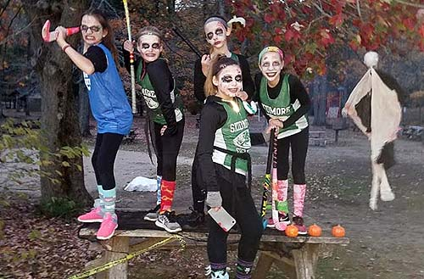
Environmental Education
100
This is a chance to visit scary stations and learn about the environment
What is the Halloween walk ?

Slide 22
Stewardship
20
These are FOMLSP members who help maintain trails at MLSP

Slide 23
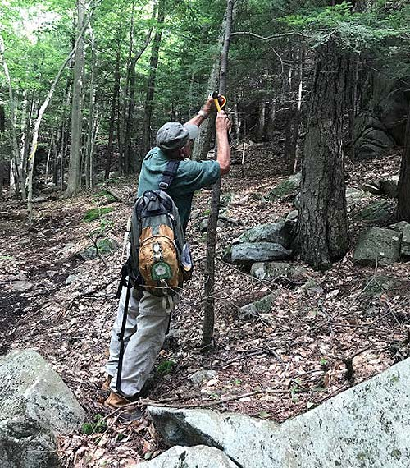
Stewardship
20
These are FOMLSP members who help maintain trails at MLSP
Who are trail stewards ?

Slide 24
Stewardship
40
This is a day when FOMLSP and others improve trails at MLSP

Slide 25
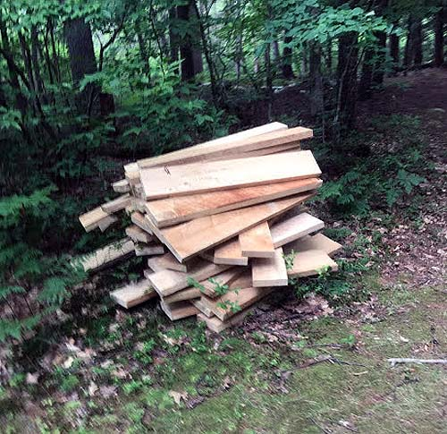
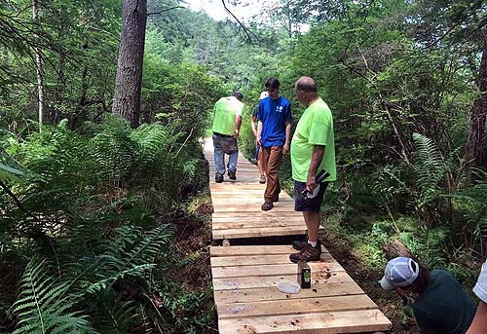
Stewardship
40
This is a day when FOMLSP and others improve trails at MLSP
What is Trails Day ?

Slide 26
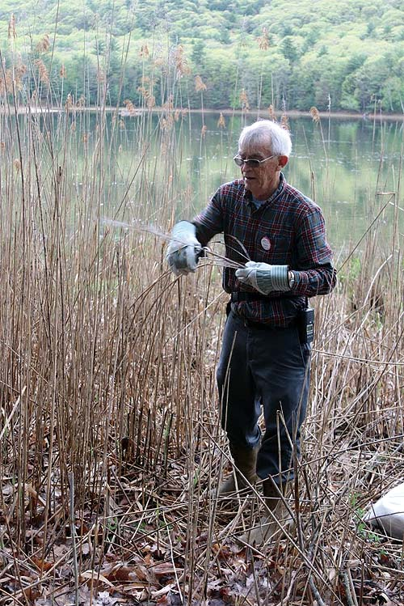
Stewardship
60
These are members of FOMLSP and others who help control invasive species at MLSP

Slide 27
Stewardship
60
These are members of FOMLSP and others who help control invasive species at MLSP
Who works with Capital / Mohawk PRISM* staff ?
* Partnership for Regional Invasive Species Management

Slide 28
Stewardship
80
This is a fine way to celebrate Earth Day with FOMLSP

Slide 29
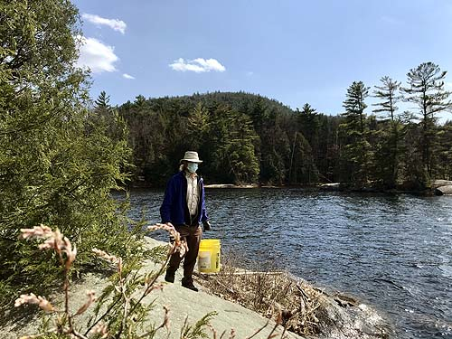
Stewardship
80
This is a fine way to celebrate Earth Day with FOMLSP
What is cleaning up the newest park property on the Hudson River ?

Slide 30
Stewardship
100
What is a fine thing to do with FOMLSP on I Love My Park Day

Slide 31
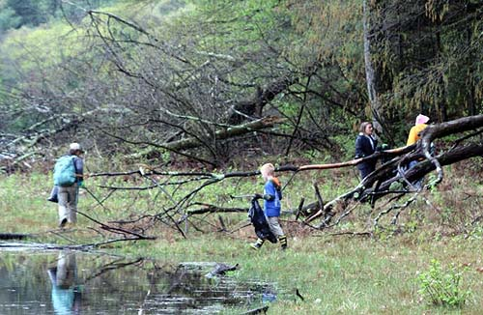
Stewardship
100
What is a fine thing to do with FOMLSP on I Love My Park Day
What is cleaning up the lake shore ?

Slide 32
Support for Park activities and events
20
This is an opportunity for FOMLSP to help start the year right

Slide 33
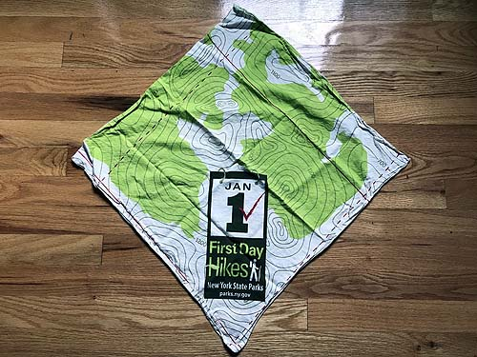
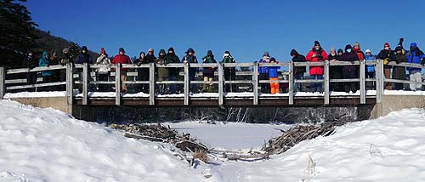
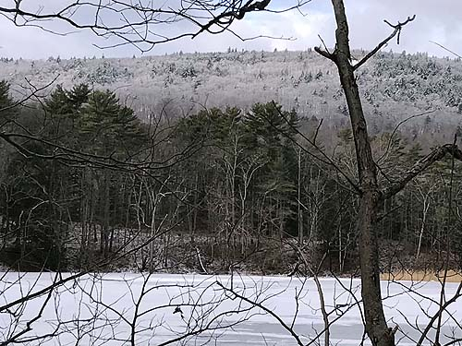
Support for Park activities and events
20
This is an opportunity for FOMLSP to help start the year right
What is the First Day hike ?

Slide 34
Support for Park activities and events
40
This is a day for FOMLSP to help drill holes in the ice and watch for tip-ups

Slide 35
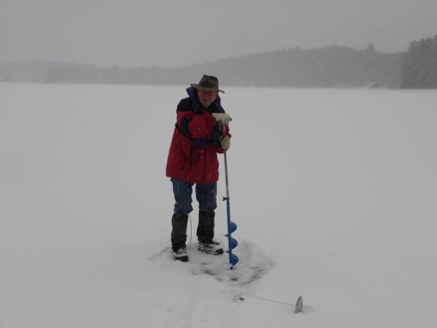
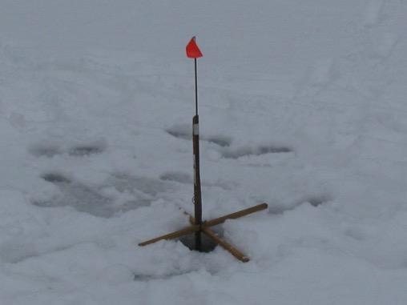
Support for Park activities and events
40
This is a day for FOMLSP to help drill holes in the ice and watch for tip-ups
What is an Ice Fishing Day ?

Slide 36
Support for Park activities and events
60
This is a day when FOMLSP helps make MLSP a great place to fish

Slide 37
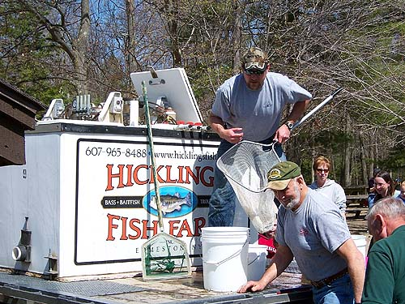
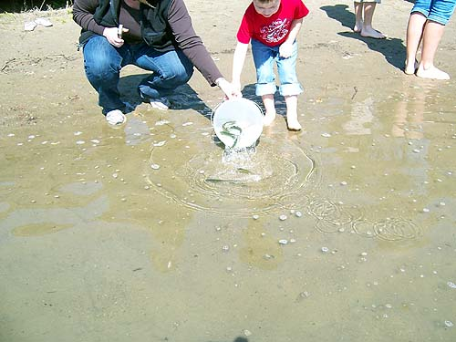
Support for Park activities and events
60
This is a day when FOMLSP helps make MLSP a great place to fish
What is fish stocking day ?

Slide 38
Support for Park activities and events
80
A day for FOMLSP to help young kids with their fishing

Slide 39
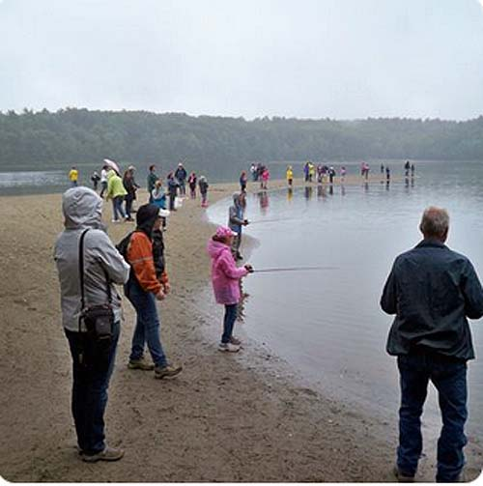
Support for Park activities and events
80
A day for FOMLSP to help young kids with their fishing
What is kids’ fishing day?

Slide 40
Support for Park activities and events
100
These are planting gardens and spreading wood chips on playgrounds

Slide 41
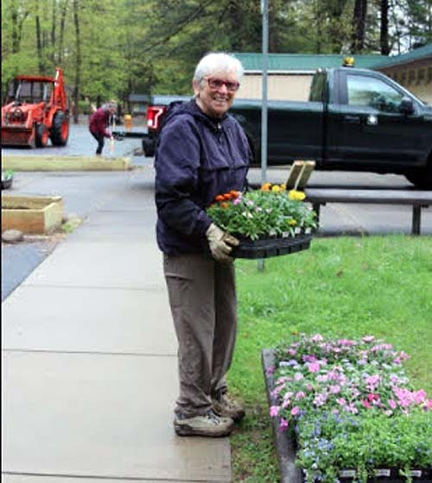
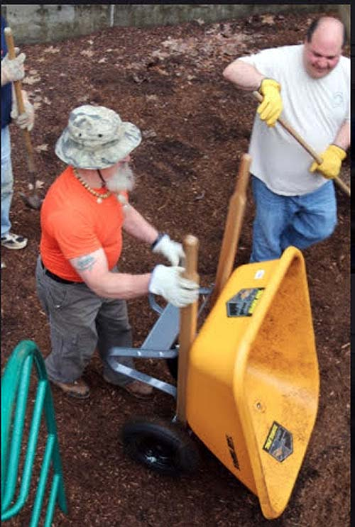
Support for Park activities and events
100
These are planting gardens and spreading wood chips on playgrounds
What are just two of the I Love My Park Day activities organized by FOMLSP

Slide 42
Activities and events sponsored by FOMLSP
20
This is a warm place where you can find a FOMLSP volunteer on a winter weekend

Slide 43
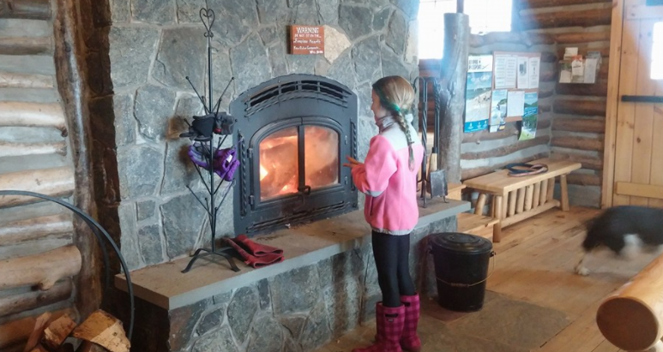
Activities and events sponsored by FOMLSP
20
This is a warm place where you can find a FOMLSP volunteer on a winter weekend
What is the Warming Hut ?

Slide 44
Activities and events sponsored by FOMLSP
40
This is a meal with more kinds of chili than you’ve ever seen before

Slide 45
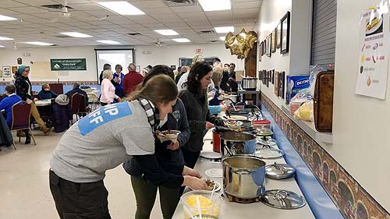
Activities and events sponsored by FOMLSP
40
This is a meal with more kinds of chili than you’ve ever seen before
What is the FOMLSP Chili Dinner ?

Slide 46
Activities and events sponsored by FOMLSP
60
This is a day when FOMLSP speaks up for MLSP at our state legislature

Slide 47
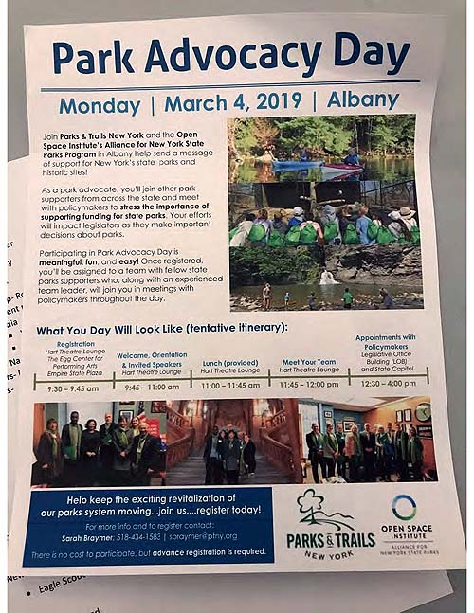
Activities and events sponsored by FOMLSP
60
This is a day when FOMLSP speaks up for MLSP at our state legislature
What is Park Advocacy Day ?

Slide 48
Activities and events sponsored by FOMLSP
80
This is a way to have fun camping at MLSP even on a rainy day

Slide 49
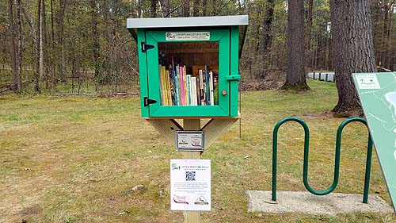
Activities and events sponsored by FOMLSP
80
This is a way to have fun camping at MLSP even on a rainy day
What is using a Little Free Library installed by FOMLSP ?

Slide 50
Activities and events sponsored by FOMLSP
100
This is an IRL or Virtual occasion for learning about many regional groups and activities related to nature

Slide 51
Activities and events sponsored by FOMLSP
100
This is an IRL or Virtual occasion for learning about many regional groups and activities related to nature
What is Nature Fest ?

