Slide 1
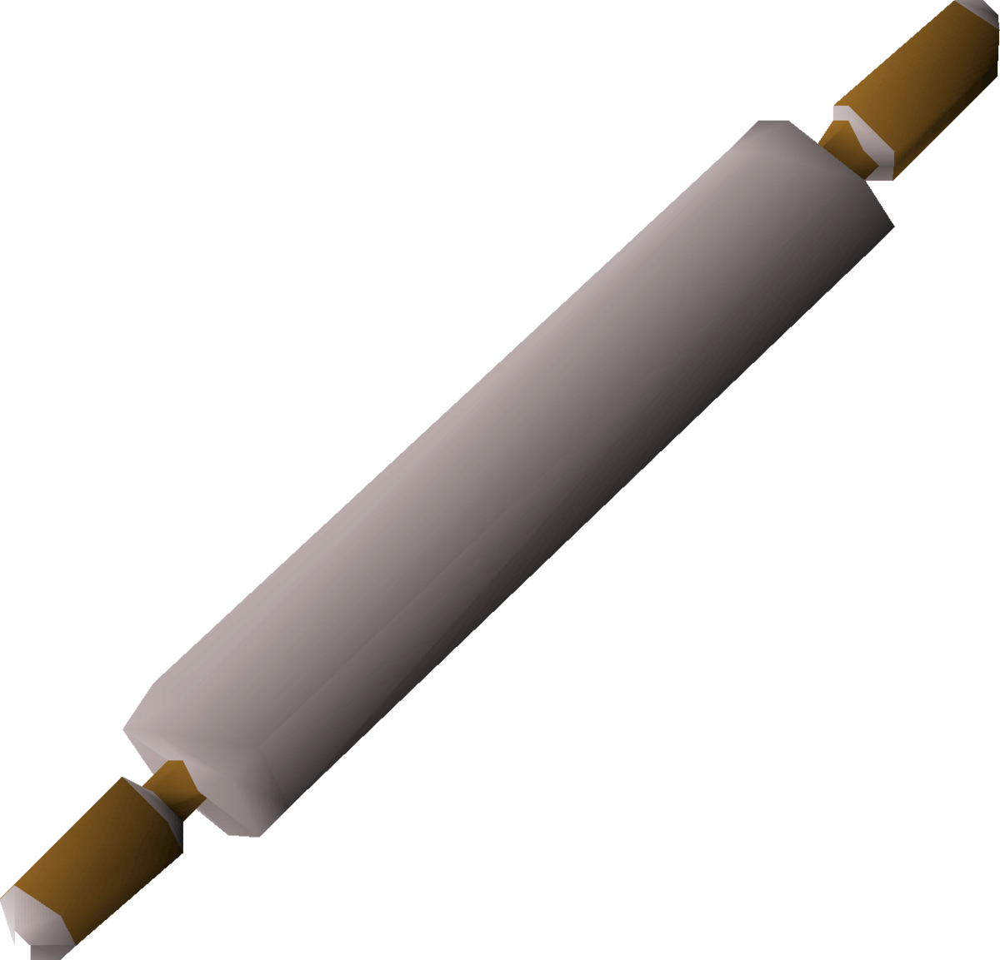
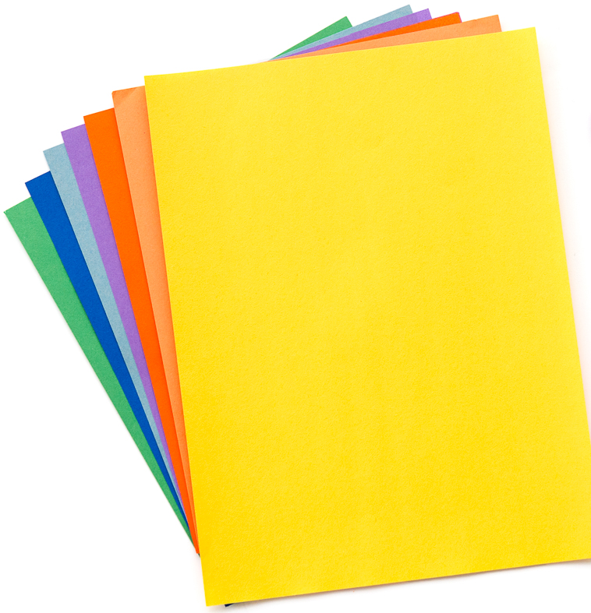
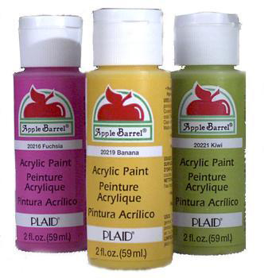
RECYCLED PAPER MAKING TIPS:
TOOLS
Don’t want to use your blender? Place water and paper pieces in a bowl and let soak for several hours or overnight. Use your hands or a fork to break down the paper into a slurry.
No deckle or picture frames…Use a piece of screen, muslin, or paper towels on a rimmed cookie sheet. Pour slurry on the screen, muslin, or paper towel and cover with another sheet of muslin or paper towel. Absorb excess water by blotting with a sponge or towels. You can also use a rolling pin to help press out excess water.
COLORING & DESIGNING YOUR PAPER
Use colored paper in your slurry.
Add a few (to several) drops of acrylic paint to your slurry and mix well.
Add flower petals or other flat natural items to enhance your paper.

