Slide 1
Moreau Lake State Park JEOPARDY
Moreau Lake State Park JEOPARDY
Terrific Trees
Something
Fishy
Feathered
Friends
Invasives
☹
Furry
Friends
Letter
- P -
20
20
20
20
20
20
40
40
40
40
40
40
60
60
60
60
60
60
80
80
80
80
80
80
100
100
100
100
100
100

Slide 2
Terrific Trees
20
This is a dog’s most favorite part of a tree.

Slide 3
Terrific Trees
20
This is a dog’s most favorite part of a tree.
The BARK !!

Slide 4
Terrific Trees
40
The official tree of New York State.

Slide 5
Terrific Trees
40
The official tree of New York State.
The Sugar Maple
Acer saccharum

Slide 6
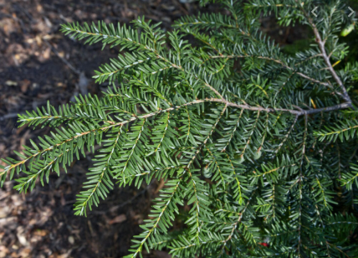
Terrific Trees
60
Along with White Pine, this is the most common conifer (evergreen) in the bark.

Slide 7
Terrific Trees
60
Eastern Hemlock
Tsuga canadensis

Slide 8
Terrific Trees
80
This is the part of the tree that collects the sunlight for Photosynthesis to supply usable energy to the tree.

Slide 9
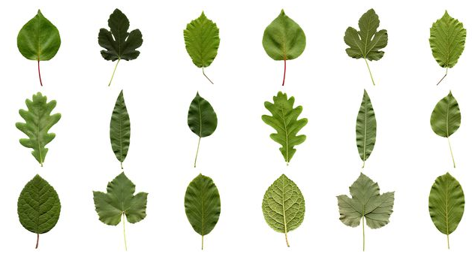
Terrific Trees
80
This is the part of the tree that collects the sunlight for Photosynthesis to supply usable energy to the tree.
Leaves or Needles

Slide 10
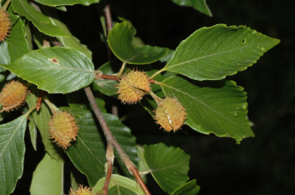
Terrific Trees
100
This common hardwood has smooth light gray bark and nuts !

Slide 11
Terrific Trees
100
This common hardwood has smooth light gray bark and nuts !
American Beech
Fagus grandifolia

Slide 12
Something Fishy
20
This is why all fish are musical.

Slide 13
Something Fishy
20
They know their SCALES ! !

Slide 14
Something Fishy
40
This is the structure that fish have that allow them to “breathe” (get O2 ) underwater.

Slide 15
Something Fishy
40
GILLS !

Slide 16
Something Fishy
60
There is a pot of GOLD under this type of trout that is heavily stocked in Moreau Lake

Slide 17
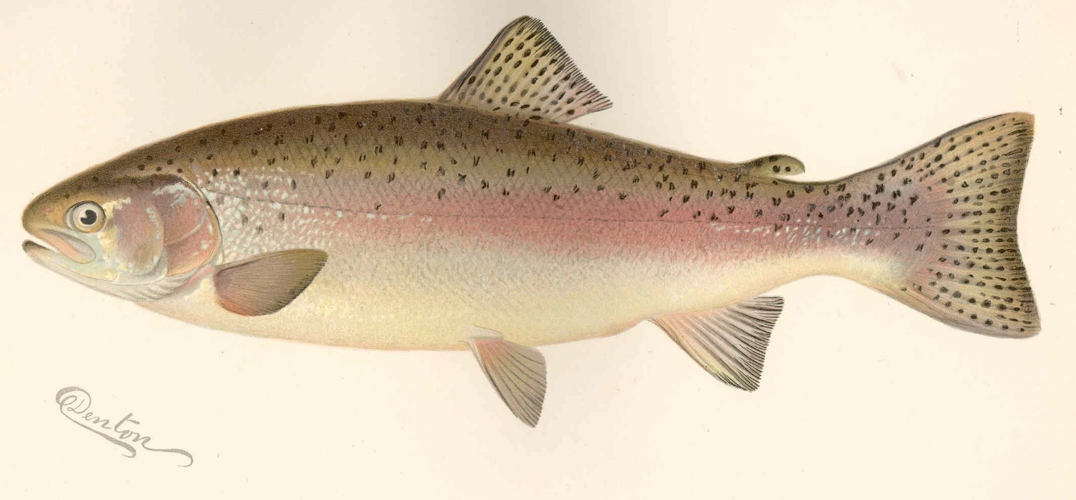
Something Fishy
60
RAINBOW TROUT

Slide 18
Something Fishy
80
These fish can have a BIG mouth or a SMALL mouth, but they are both tasty.

Slide 19
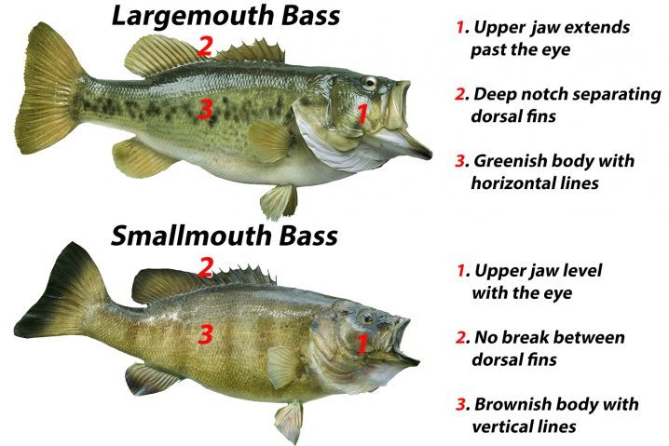
Something Fishy
80
BASS

Slide 20
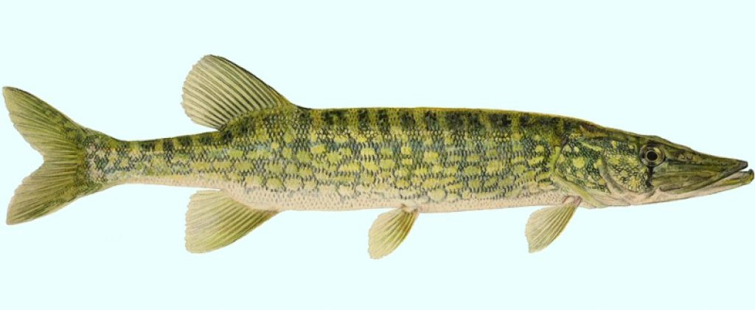
Something Fishy
100
This fish is often caught by folks ice fishing in the winter.

Slide 21
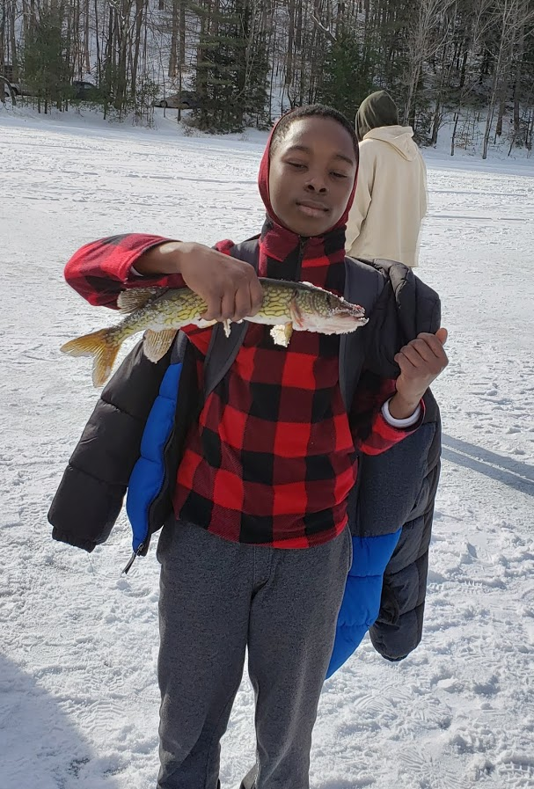
Something Fishy
100
Chain
Pickerel

Slide 22
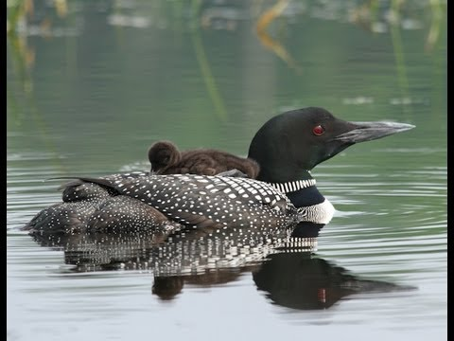
Feathered Friends
20
You may have heard the erie calls of this seasonal visitor in the morning or eveing out on the lake.

Slide 23
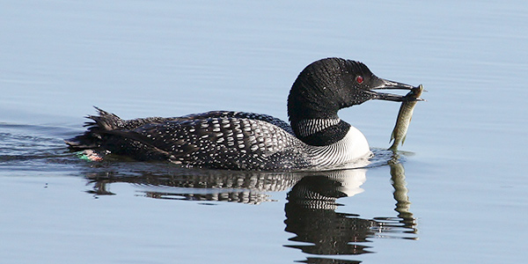
Feathered Friends
20
The Common Loon

Slide 24
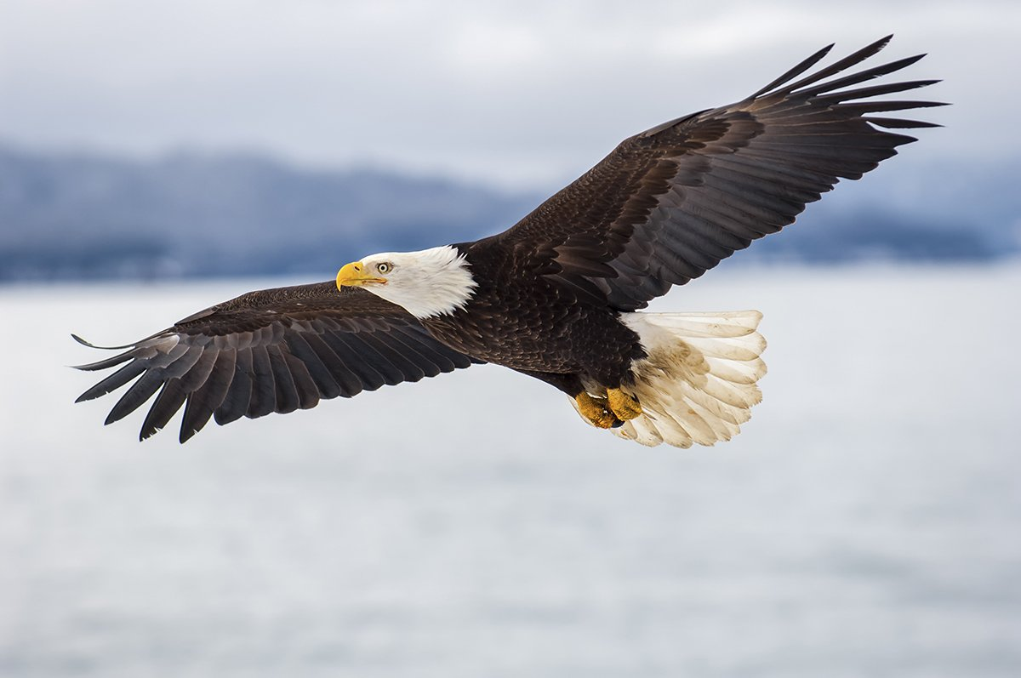
Feathered Friends
40
This raptor, (the symbol of our country), is a common site at the Park .

Slide 25
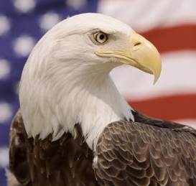
Feathered Friends
40
BALD EAGLE
Haliaeetus leucocephalus

Slide 26
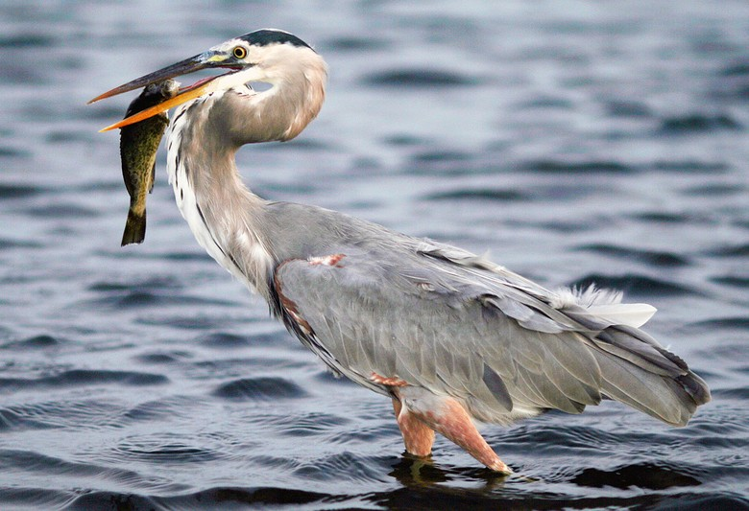
Feathered Friends
60
You can often see this great bird wading along the shore looking for fish and other critters to eat.

Slide 27
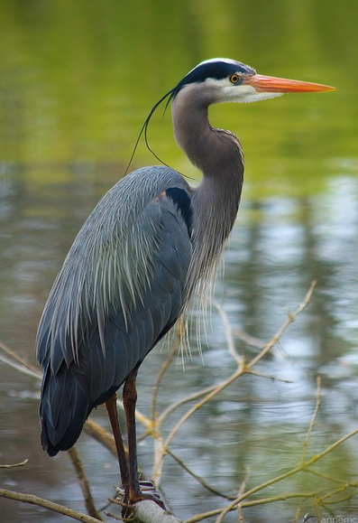
Feathered Friends
60
Great Blue Heron

Slide 28
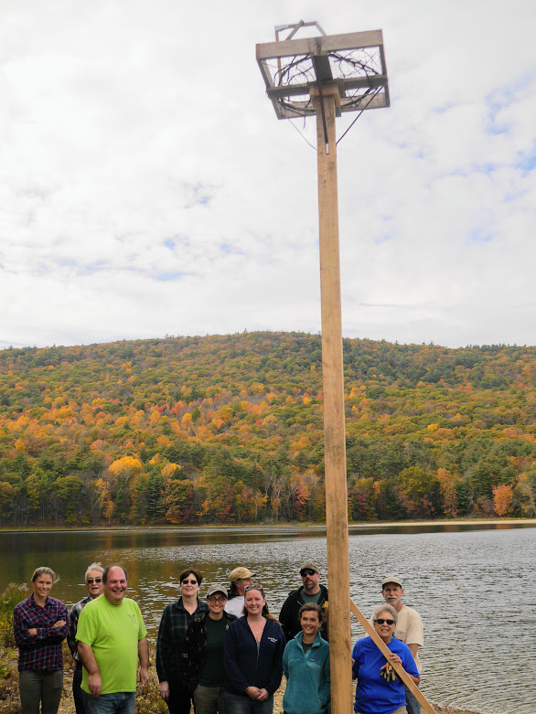
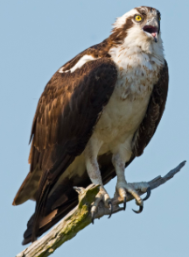
Feathered Friends
80
A nesting platform for this fish loving raptor was erected at the park.

Slide 29
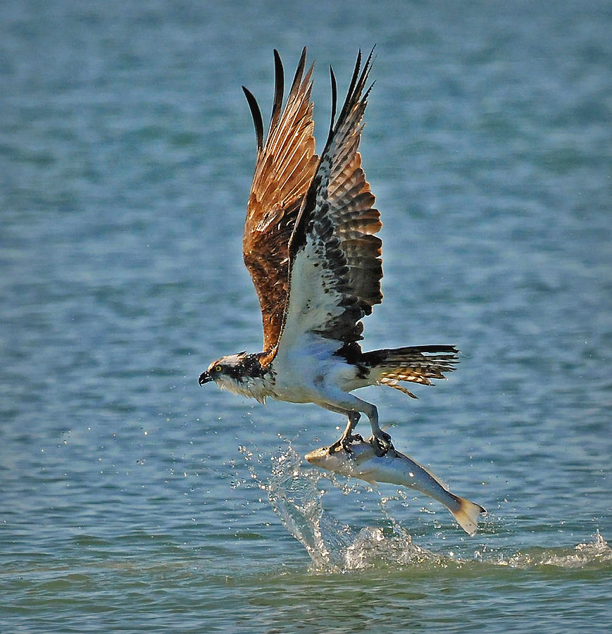
Feathered Friends
80
OSPREY

Slide 30
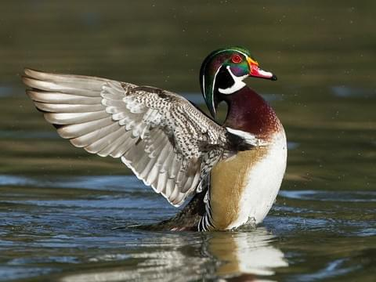
Feathered Friends
100
This type of duck is the logo for the Friends of Moreau Lake

Slide 31
Feathered Friends
100
The WOOD DUCK

Slide 32
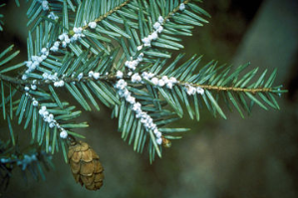
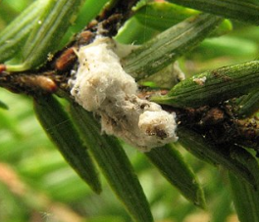
Invasives ☹
20
This insect has wreaked havoc on our trees throughout the state and could be a serious problem in our park.

Slide 33
Invasives ☹
20
Hemlock Woolly Adelgid

Slide 34
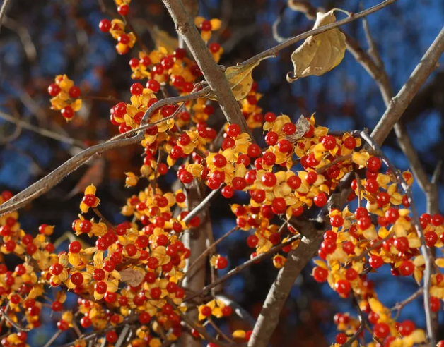
Invasives ☹
40
Although pretty in the Fall, this vine smothers our native plants by blocking out sunlight and competing for root space.

Slide 35
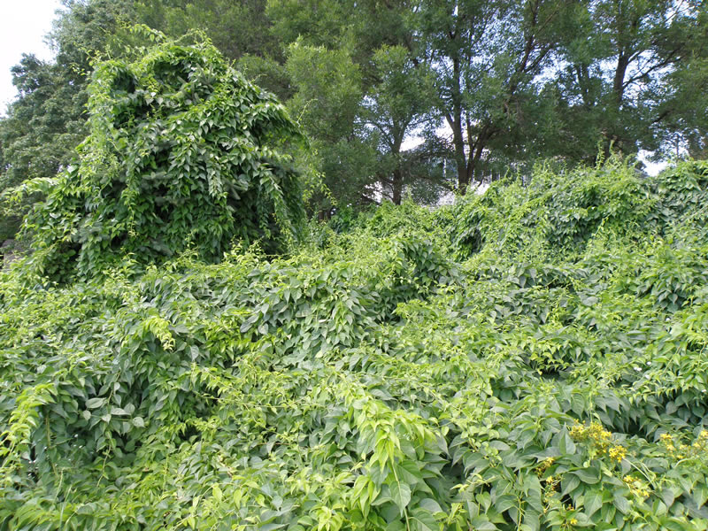
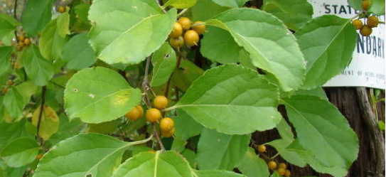
Invasives ☹
40
Oriental Bittersweet
Oriental Bittersweet

Slide 36
Invasives ☹
60
This plant has taken over many of our river banks and road sides.

Slide 37
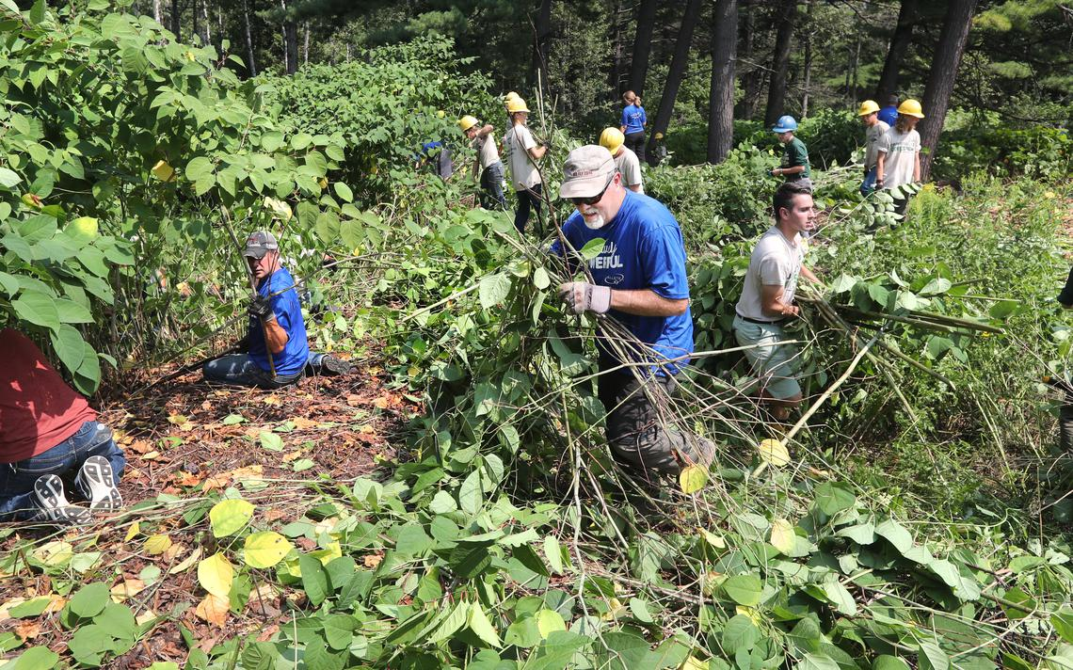
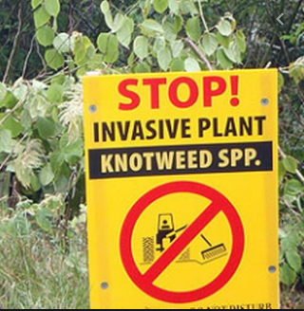
Invasives ☹
60
Japanese Knotweed

Slide 38
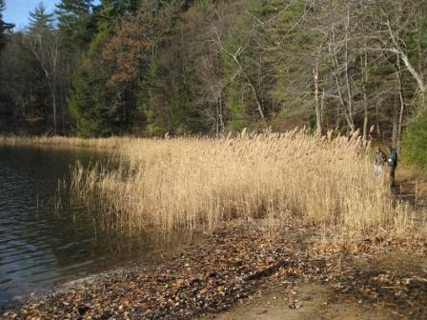
Invasives ☹
80
Unfortunately this grass (reed) has taken over many areas along the shoreline.

Slide 39
Invasives ☹
80
PHRAGMITES
(Common Reed Grass)

Slide 40
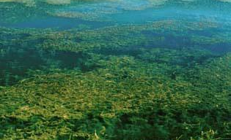
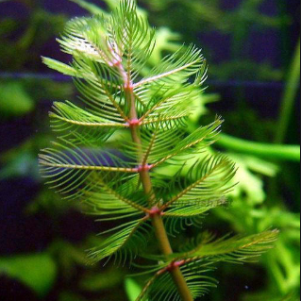
Invasives ☹
100
This aquatic plant could “choke out” the lake.

Slide 41
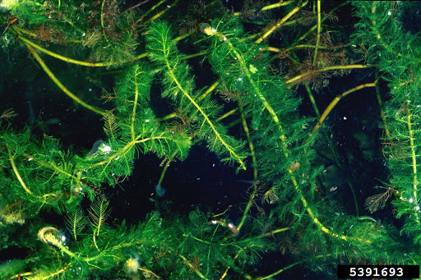
Invasives ☹
100
Eurasian Water-milfoil

Slide 42
Furry Friends
20
This taxonomic grouping (Class) contain animals with hair, maintain a constant body temperature , and produce milk for their young.

Slide 43
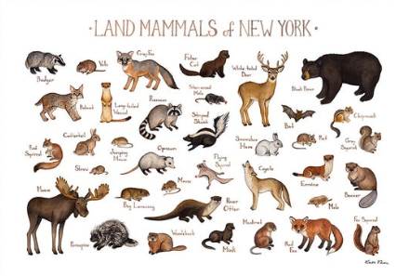
Furry Friends
20
MAMMALS

Slide 44
Furry Friends
40
This squirrel is quite common but rarely seen as it active at night (nocturnal) gliding from tree to tree.

Slide 45
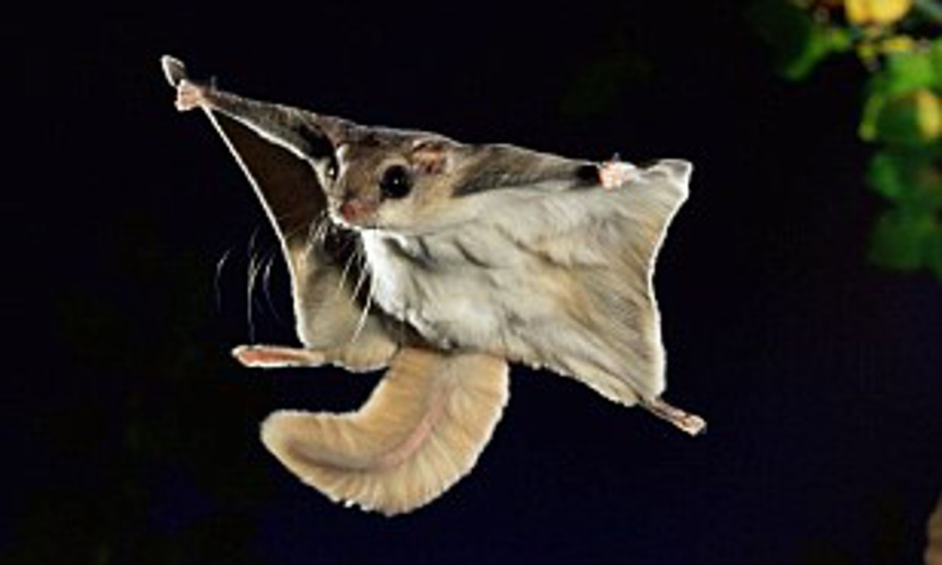
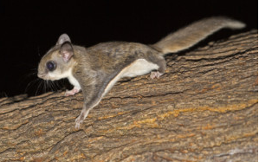
Furry Friends
40
Flying Squirrel

Slide 46
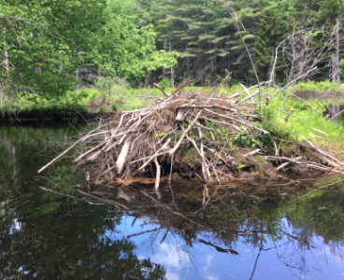
Furry Friends
60
This is the Official Animal of New York Sate, has a house at Moreua Lake and loves to eat the bark and leaves of our “poplars”.

Slide 47
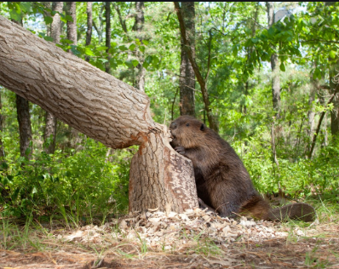
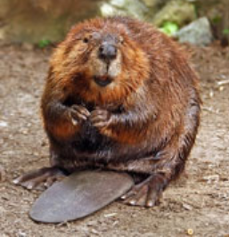
Furry Friends
60
BEAVER

Slide 48
Furry Friends
80
Next to squirrels, these are the most common animals you will find in the park !

Slide 49
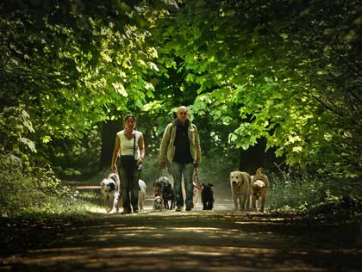
Furry Friends
80
Dogs and their Human owners.

Slide 50
Furry Friends
100
Although very rare at Moreau Lake Sate Park, it is the largest Animal in New York State.

Slide 51
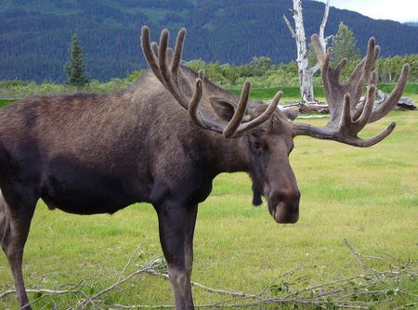
Furry Friends
100
MOOSE

Slide 52
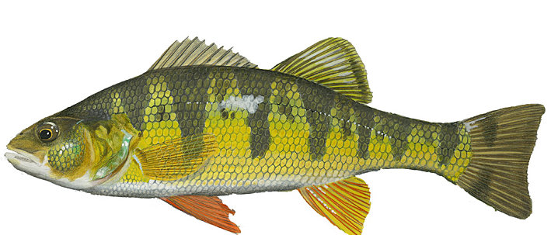
Starts with the letter P
20
This is one the tastiest fish in the Lake.

Slide 53
Starts with the letter P
20
PERCH

Slide 54
Starts with the letter P
40
Don’t touch this plant unless you want to itch.
(Leaves of three, let it be.)

Slide 55
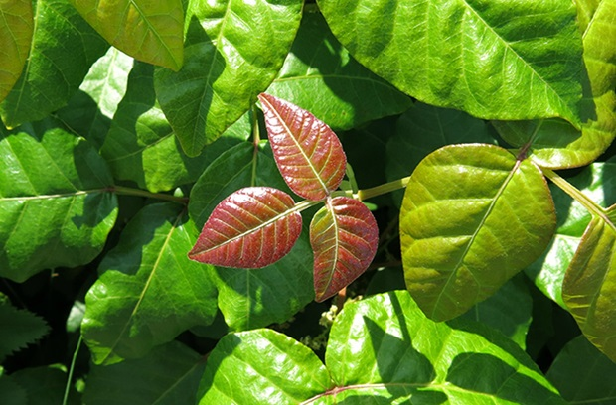
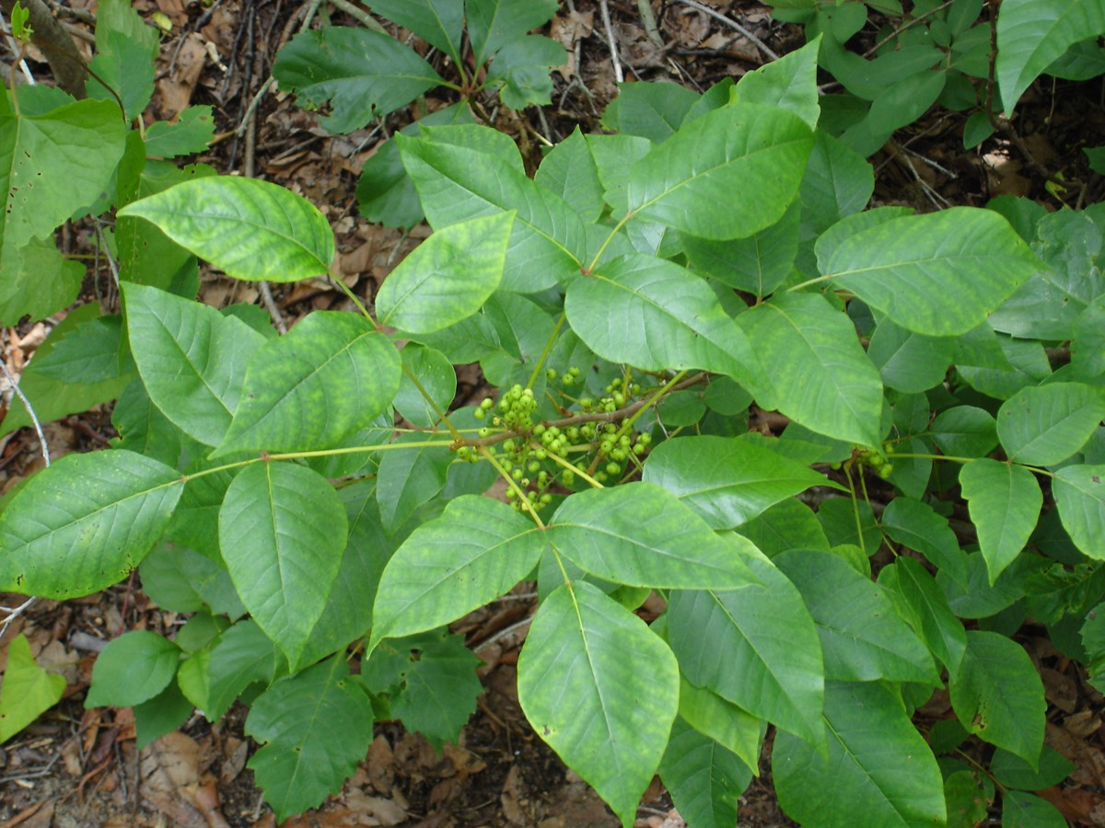
Starts with the letter P
40
Poison Ivy

Slide 56
Starts with the letter P
60
White, Pitch, and Scots are all examples of these found in the park.

Slide 57
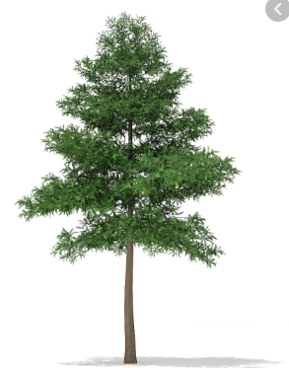
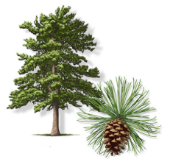
Starts with the letter P
60
PINES Pinus sp.

Slide 58
Starts with the letter P
80
Don’t get too close to this pin cushion with four legs, be especially be careful around dogs.

Slide 59
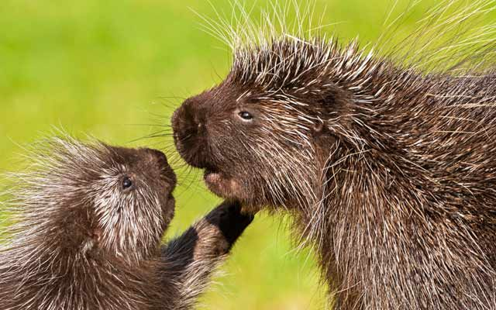
Starts with the letter P
80
Porcupine

Slide 60
Starts with the letter P
100
These colorful reptiles wear their colors on their shell.

Slide 61
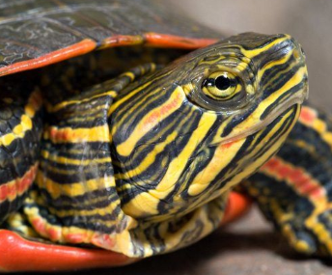
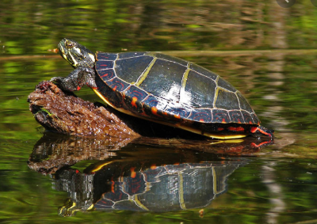
Starts with the letter P
100
Painted Turtle

